Slide 1
14.2 From Stumps to Deep Trees

Slide 2
The stump

Slide 3

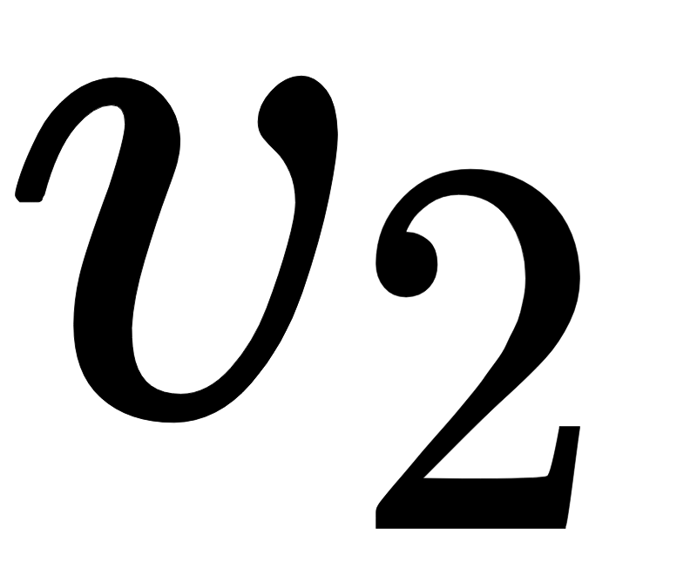
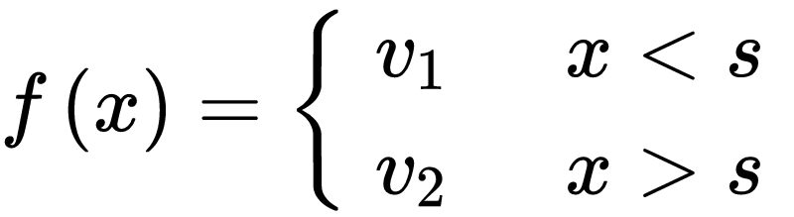
The most basic tree-based universal approximator, the stump, is a simple step function with three parameters:
two step levels or *leaf* parameters denoted by and (whose values are set independently of one another), and
a split point parameter s defining the boundary between the two levels.

Slide 4
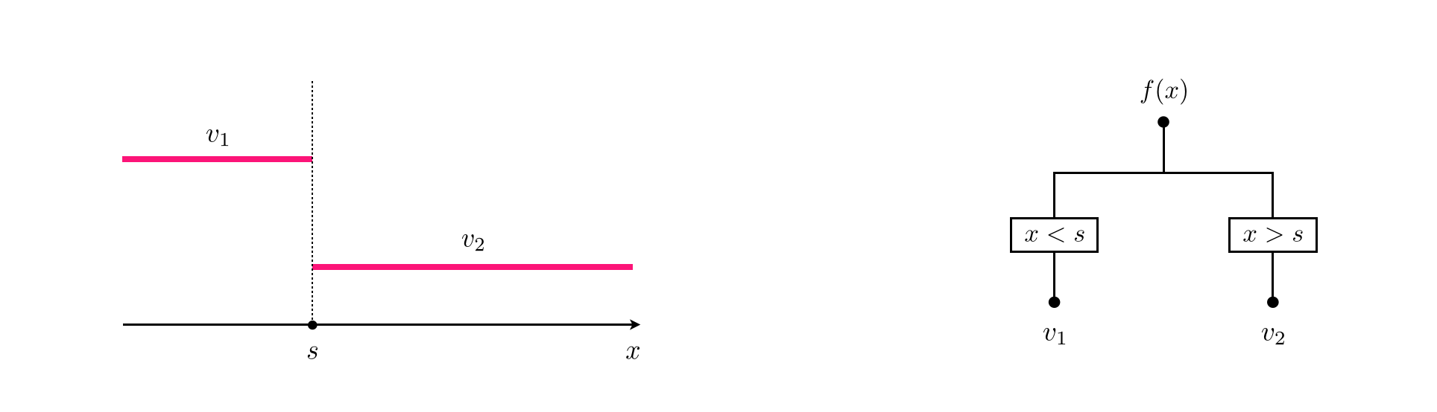
(left) A simple stump has three parameters: , , and ‘s’. (right) An illustration of a stump function as a binary tree structure of depth one.

Slide 5
Creating deep trees via recursion

Slide 6
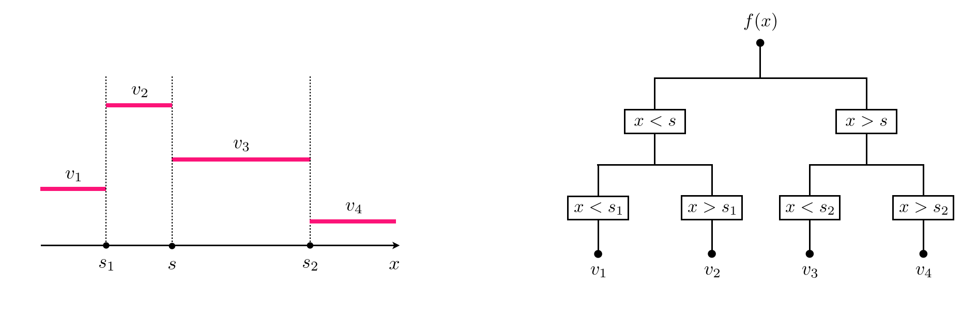
Given a depth one tree (a stump), each leaf can be recursively split up into two new leaves, introducing two new split points and creating a total of four distinct leaves.

Slide 7
Using recursion we can construct deeper trees in a similar manner.
The deeper a tree becomes the more capacity it gains, being able to take on a wider variety of shapes.
In the following example, we visualize 4 instances of a depth D=2 tree (top row) with 4 instances of a depth D=10 tree where all parameters are set randomly.

Slide 8
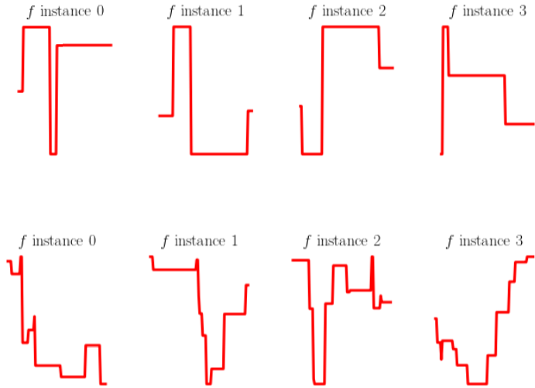

Slide 9
Creating high capacity trees via addition

Slide 10
Deeper, more flexible trees can also be constructed via *addition* of shallower trees in general, and stumps in particular.

Slide 11
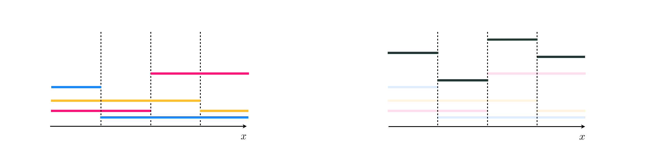
(left) Three stumps, each depicted in a distinct color. (right) A depth two tree (in black), made via addition of the three depth one trees shown in the left panel.

Slide 12
Human interpretability

Slide 13
Given their particularly simple structure, shallow tree-based units are often easy to interpret by humans, in comparison to their fixed-shape and neural network counterparts.
However, this feature of tree-based units quickly dissipates as the depth of a tree is increased as well as when trees are combined or ensembled together.

